Slide 1
Cell Processes
The CELL must undergo certain processes in order to ensure the survival of the organism as a whole.

Slide 2
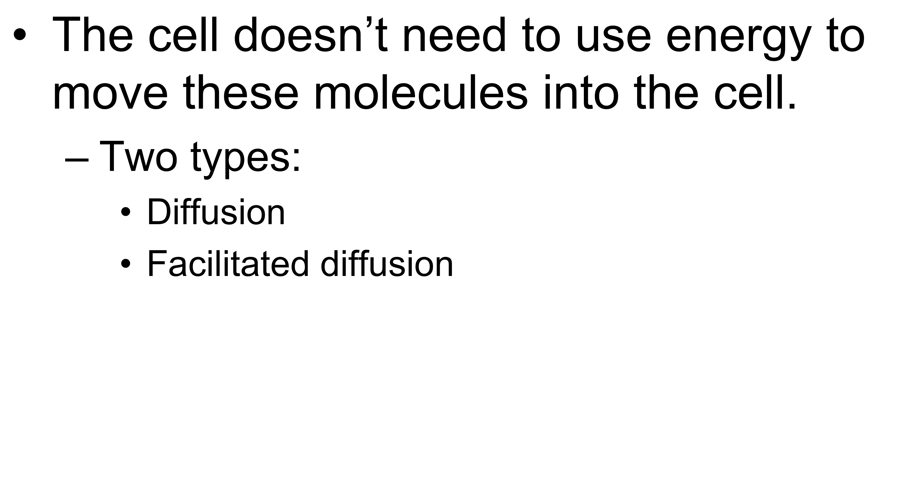
Passive Transport

Slide 3
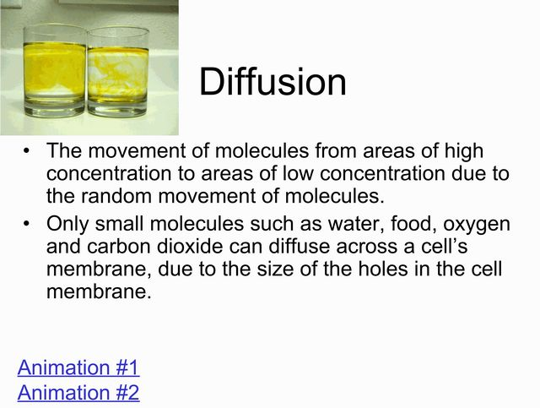

Slide 4
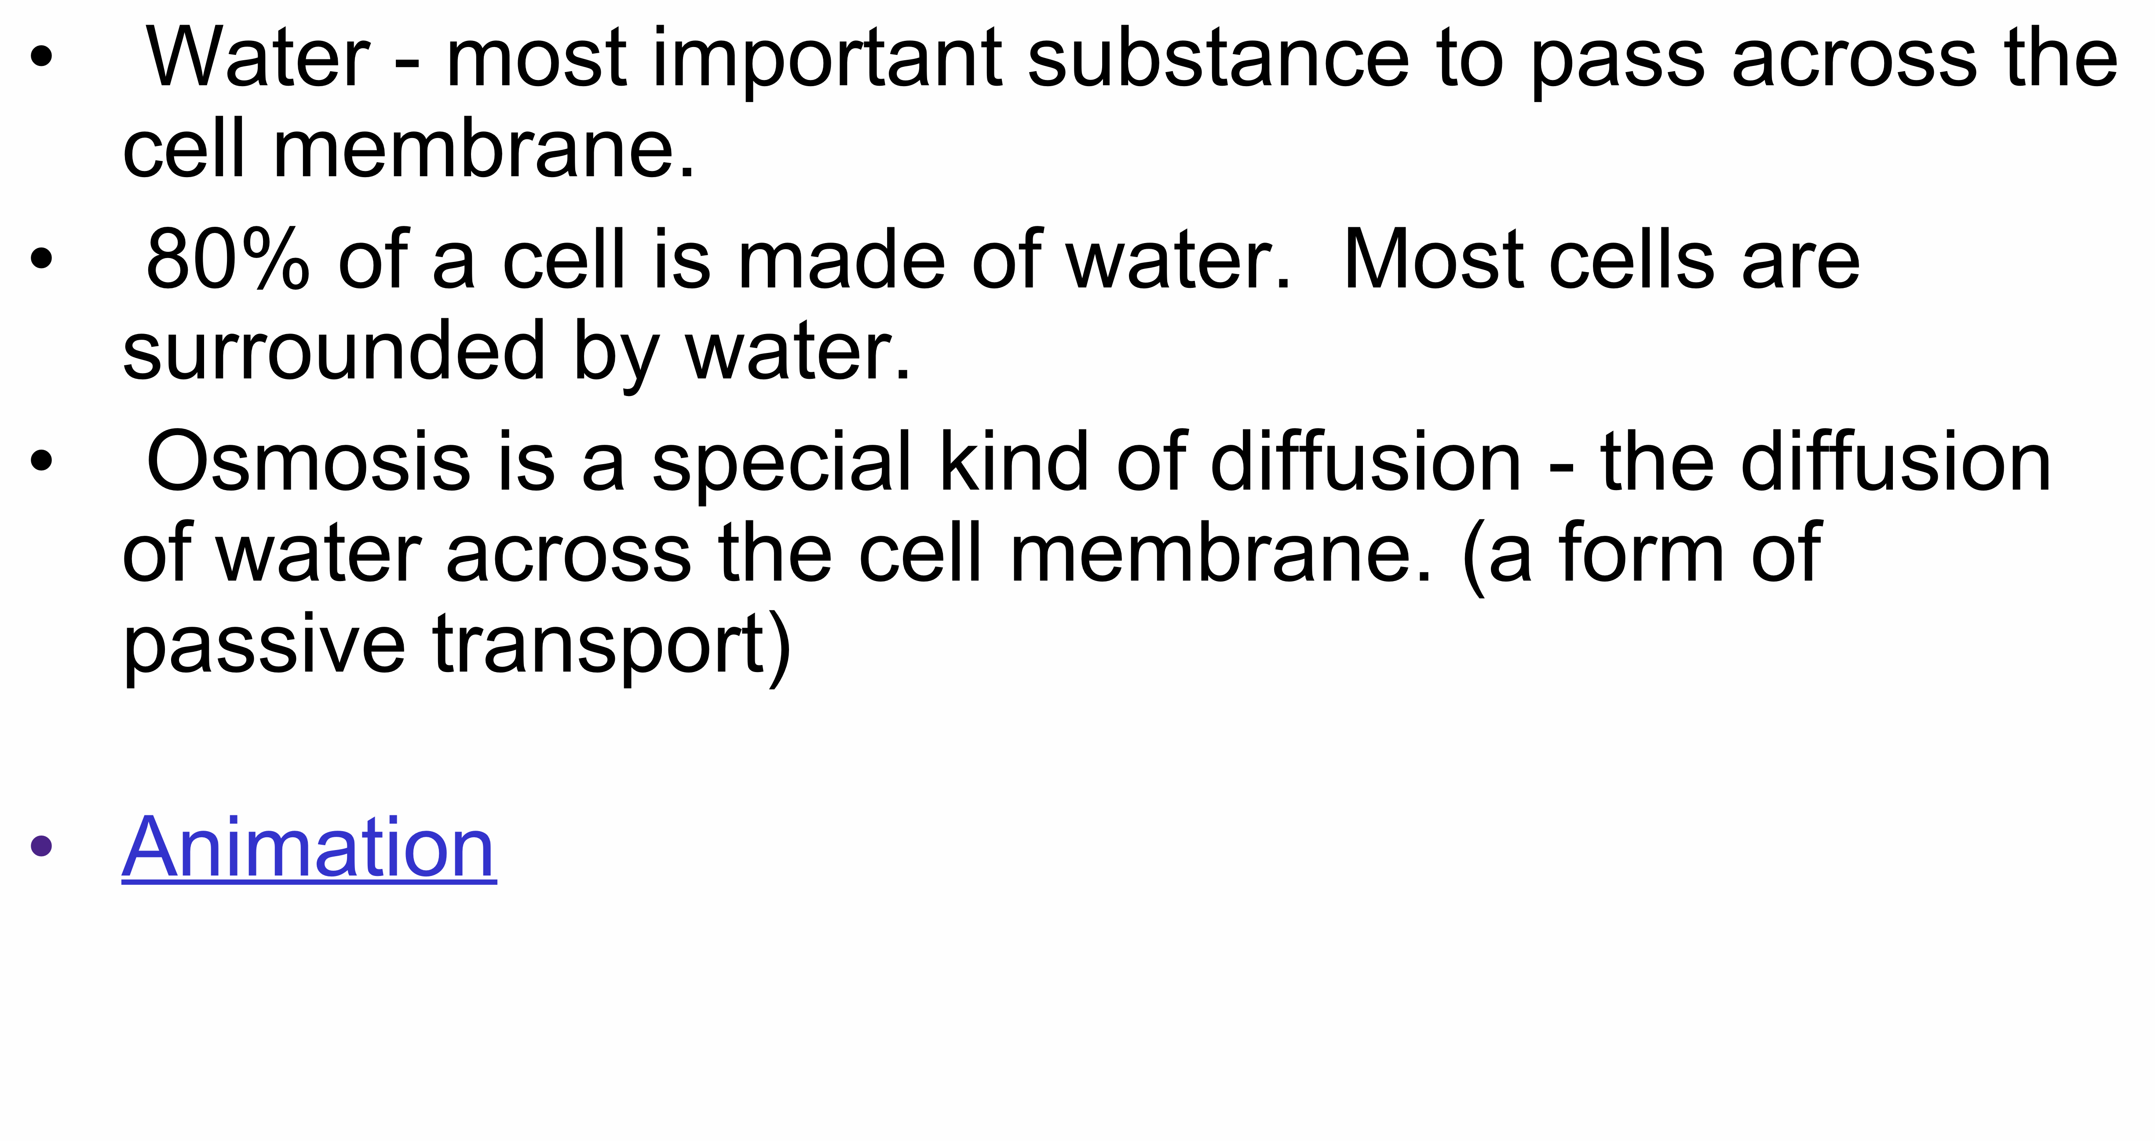
Why is Osmosis (the movement of water) so important to the cell?

Slide 5
Cell Process Animations
Osmosis & Diffusion
Diffusion - Osmosis Together
Click on Passive then next them simple...K?
The Lump Dissolves (on its own…..)

Slide 6
Cell Process Animations
Osmosis & Diffusion – continued
Diffusion
Slow Motion Diffusion
Virtual Lab from Glencoe....!!!!!!

Slide 7
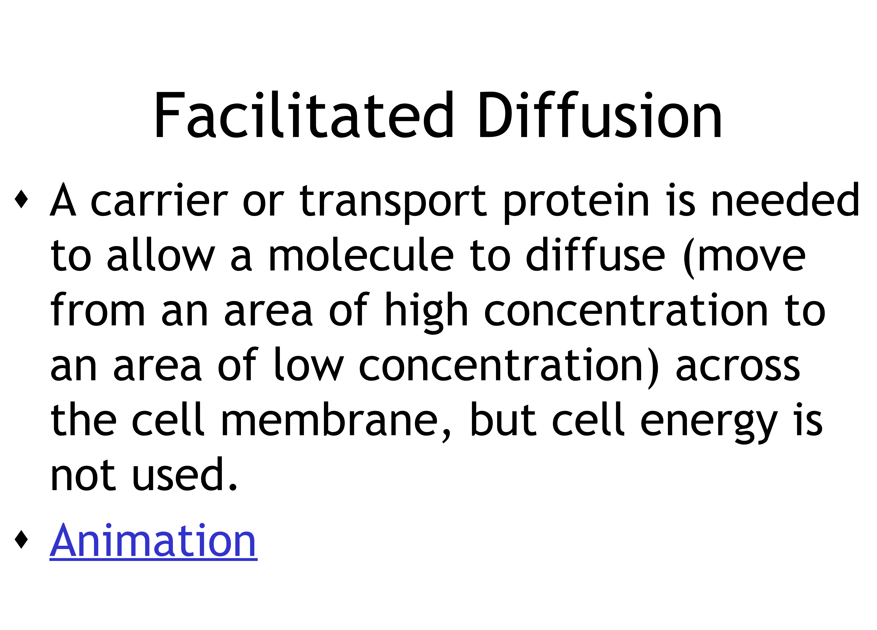
Animation

Slide 8
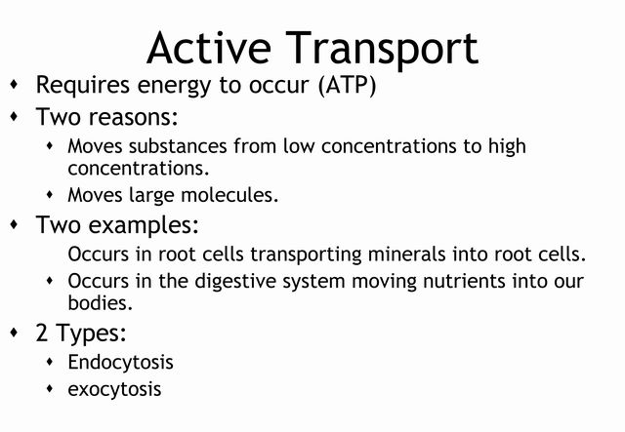

Slide 9
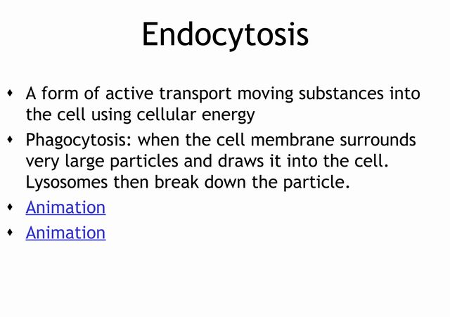

Slide 10
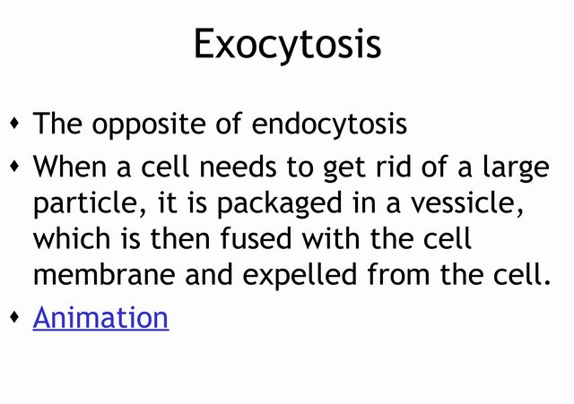

Slide 11
Endocytosis & Exocytosis
Animation

Slide 12
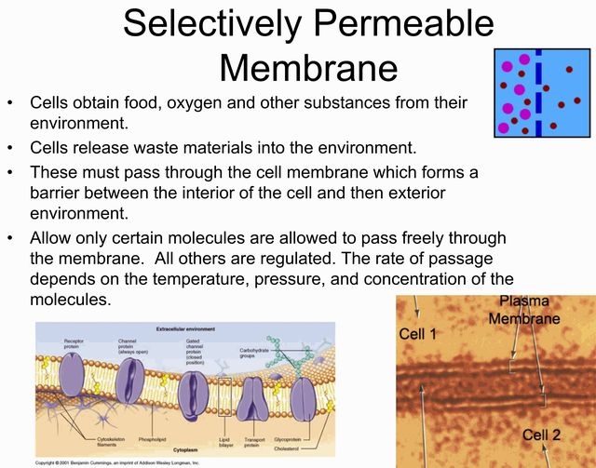

Slide 13
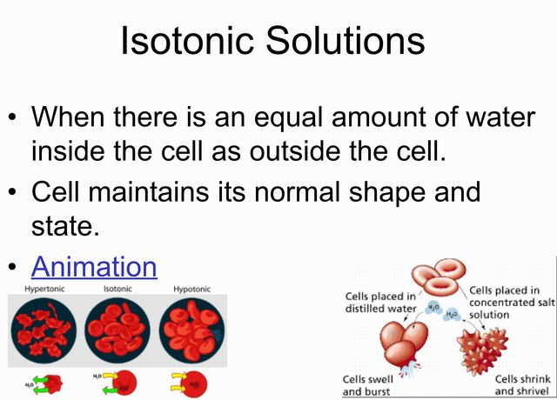
Isotonic solutions animation
Click

Slide 14
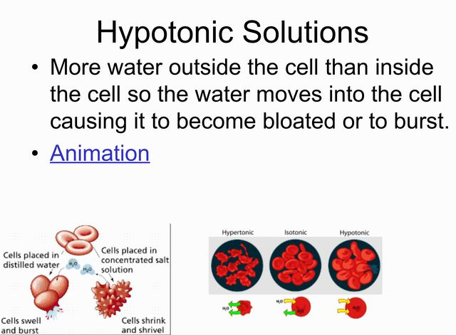

Slide 15
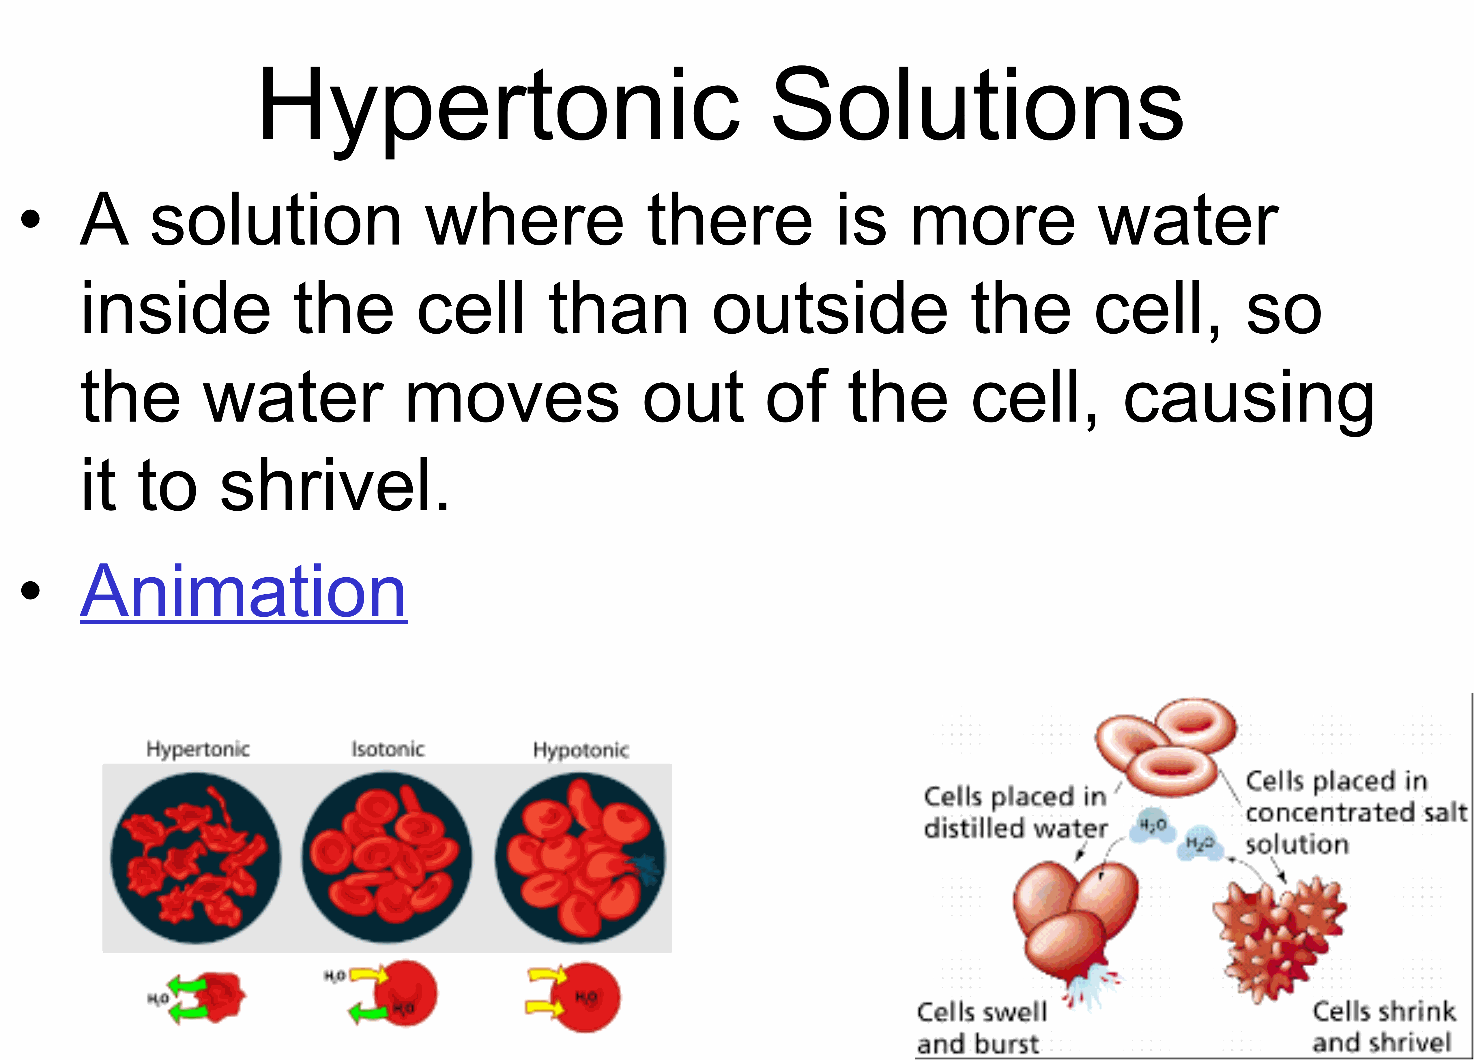

Slide 16
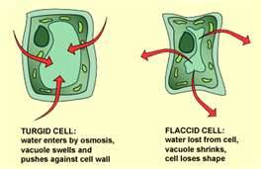
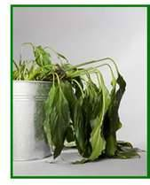
PLASYMOLOSIS
The shrinking of the cytoplasm of a cell due to diffusion of water out of the cell into a hypertonic solution (high salt concentrations).
Cell membrane pulls away from cell wall.
Water regulation is one of the main jobs of the central vacuole in plants. It expands and shrinks as water diffuses into and out of a plant cell. Losing water from inside a plant cell causes the cell to shrink. This reduces the pressure against the cell wall and cause the plant to wilt.

Slide 17

Photosynthesis
Plants use light energy (sunlight) to combine carbon dioxide (CO₂) and water (H₂O) to make simple sugars (C₆H₁₂O₆)

Slide 18
Why is this important to us?
We cannot make our own food (glucose or energy) we must get our food from plants.
Plants are the first step in the food chain.

Slide 19
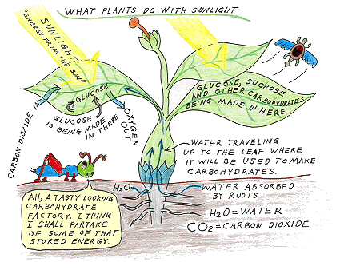

Slide 20
What is all this “food” (better known as glucose) used for?
It can be used by the plant to make energy in the mitochondria
It can be stored by the plants in vacuoles
It can be eaten by a consumer

Slide 21
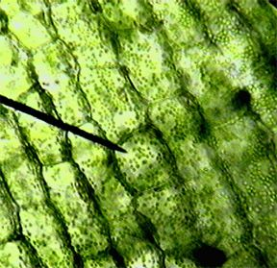
What happens during photosynthesis?
Chloroplasts in plant cells capture light energy and use that energy to make glucose or “food”
Oxygen gas is also released as a by-product in this reaction

Slide 22
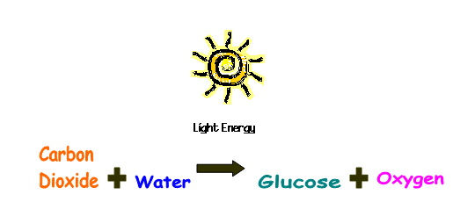
Photosynthesis

Slide 23
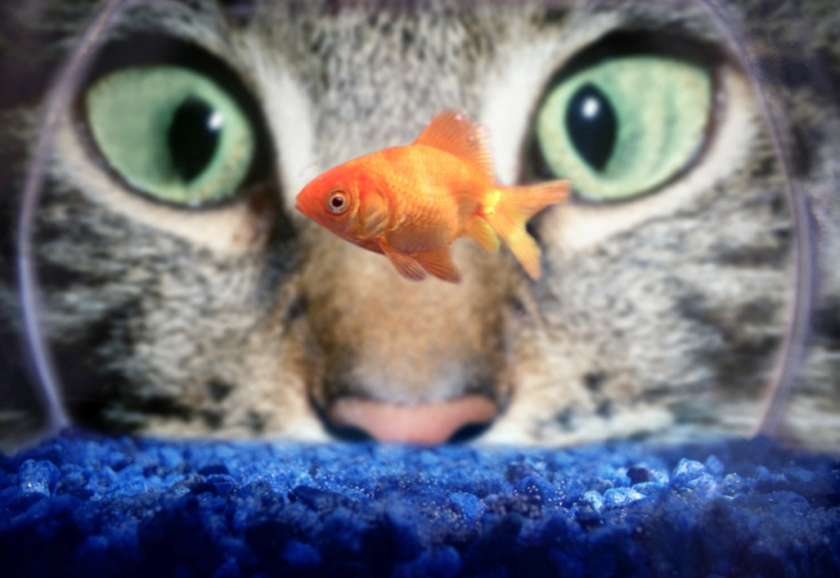
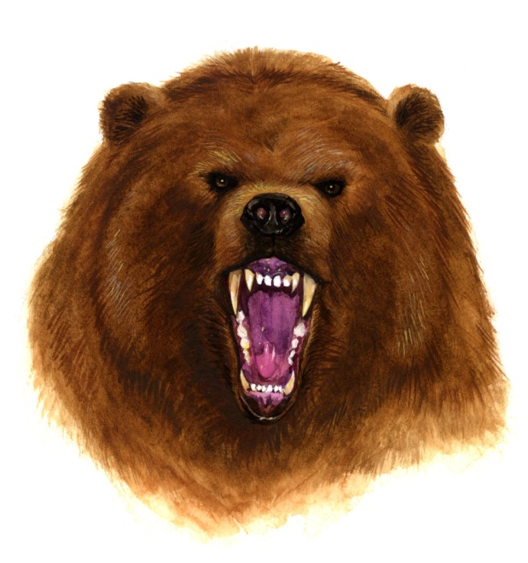

Cellular Respiration
ALL organisms break down simple sugars (C₆H₁₂O₆) for the energy they contain

Slide 24
Cellular Respiration
Sugar is broken down into Carbon Dioxide (CO₂) and Water (H₂O)
The Chemical Formula looks like this:
C₆H₁₂O₆ + O_{2 →} CO₂ + H₂O + ENERGY
Sugar + Oxygen → Carbon Dioxide + water + ENERGY
Or in English…….

Slide 25
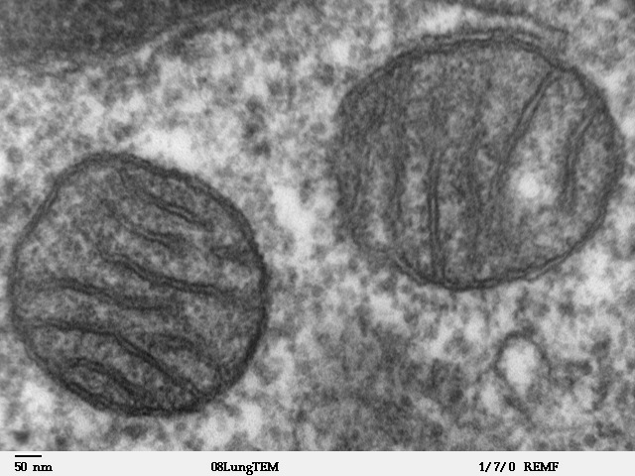
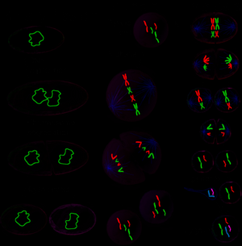
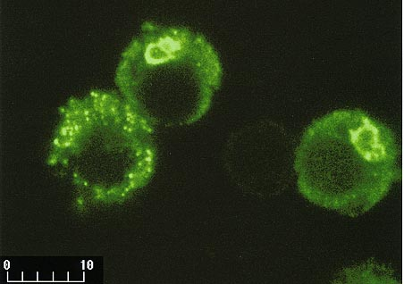

What’s this energy for?
To build new cell parts
To repair cell parts
To reproduce cells

Slide 26
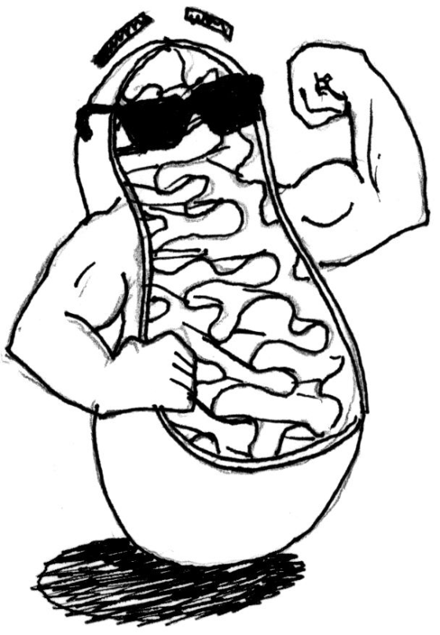
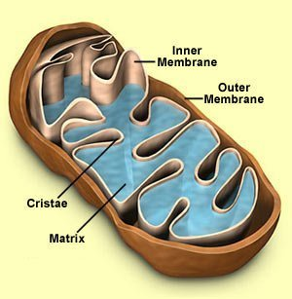
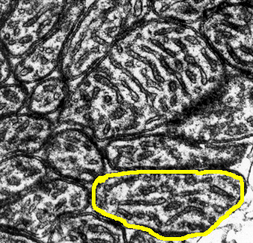
Where does it happen?
Cellular Respiration occurs in the mitochondria!!!

